Slide 1

IBM Data Analysis Capstone Project
Debanik Dutta

Slide 2

OUTLINE
Executive Summary
Introduction
Methodology
Results
  Visualization – Charts
  Dashboard
Discussion
  Findings & Implications
Conclusion
Appendix

Slide 3

EXECUTIVE SUMMARY
This study analyzes a global developer survey to understand current technology usage and future trends in the software industry. After cleaning and preparing the dataset, key technologies were compared across present and future preferences. The analysis reveals strong dominance of the JavaScript ecosystem, sustained importance of SQL and PostgreSQL, and growing adoption of modern, scalable technologies such as TypeScript, Redis, and cloud platforms.
Demographic insights show that the workforce is largely young and globally distributed, with higher education playing a significant role in participation. Overall, the findings highlight a clear industry shift toward data-driven, cloud-first, and performance-oriented development, offering actionable insights for developers, educators, and organizations when planning skills, curricula, and technology stacks.

Slide 4

INTRODUCTION
The rapid evolution of software technologies has created a dynamic and highly competitive development landscape. Understanding which programming languages, databases, and platforms are currently in use—and which are expected to gain importance in the future—is essential for developers, organizations, and educators.
This study analyzes a global developer survey to examine technology usage patterns, future preferences, and demographic trends within the developer community. By leveraging data analysis and visualization techniques, the project aims to identify dominant technologies, emerging trends, and their implications for skill development and industry adoption.

Slide 5

METHODOLOGY
Data Source: Used a developer survey dataset containing demographic, technology usage, and preference-related responses.
Data Cleaning: Removed duplicates, handled missing values, and standardized column names for consistency.
Data Preparation: Split multi-valued fields (languages, databases, platforms) into analyzable formats.
Data Transformation: Aggregated responses to calculate frequencies and top-10 rankings.
Comparative Analysis: Compared current usage vs. future preferences for technologies.
Visualization: Created bar charts, pie charts, maps, and word clouds to highlight key patterns.
Dashboard Development: Built an interactive dashboard using IBM Cognos Analytics.
Interpretation: Analyzed trends across age, education, geography, and technology categories.
Reporting: Summarized insights into findings, discussions, implications, and conclusions for presentation.

Slide 6
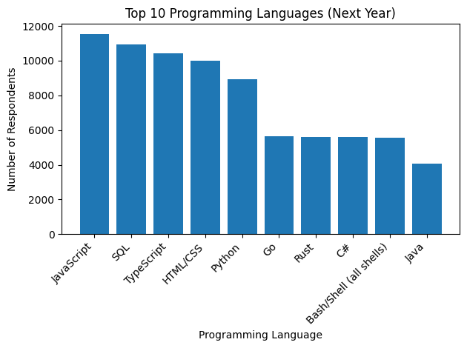
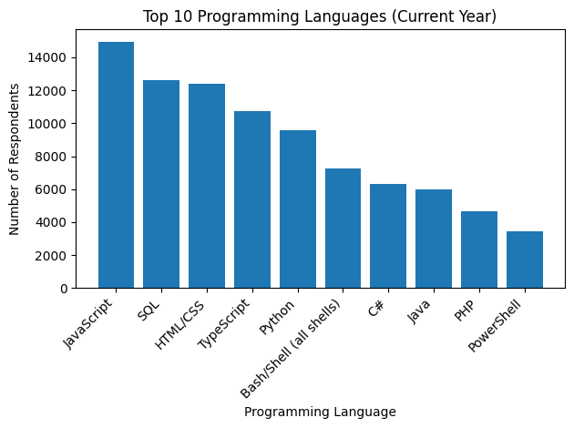
PROGRAMMING LANGUAGE TRENDS
Current Year
Next Year

Slide 7
PROGRAMMING LANGUAGE TRENDS - FINDINGS & IMPLICATIONS
Findings
JavaScript leads in both years → continues to dominate development.
SQL remains essential → strong demand for data-driven roles.
TypeScript rising → preference for scalable, maintainable code.
Python stays important → core for AI, ML, and automation.
Go & Rust gaining traction → focus on performance and systems.
Implications
Prioritize JS, SQL, TypeScript for employability.
Add Python or Go/Rust based on specialization.
Data skills are mandatory, not optional.
Shift toward scalable, high-performance systems.
Tech stacks should modernize gradually.

Slide 8
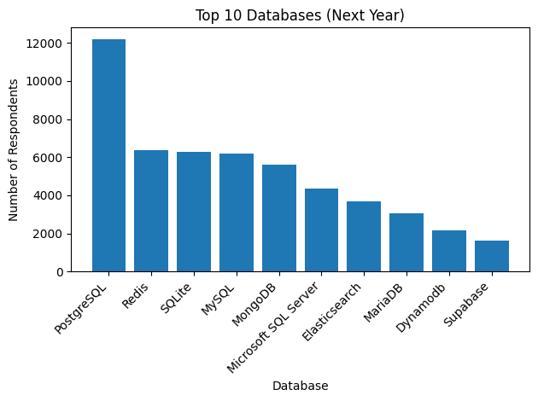
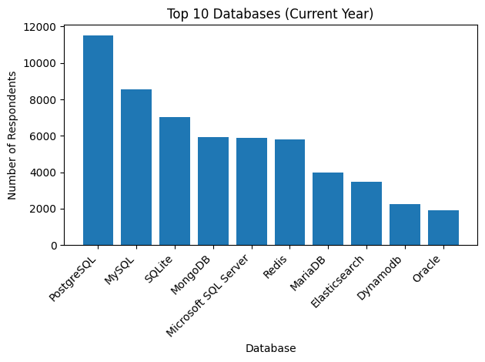
DATABASE TRENDS
Current Year
Next Year

Slide 9
DATABASE TRENDS - FINDINGS & IMPLICATIONS
Findings
PostgreSQL leads in both years → most preferred database.
MySQL declines slightly → still widely used but losing share.
SQLite stays strong → popular for lightweight and embedded use.
Redis gains interest → growing need for caching & real-time systems.
NoSQL remains relevant → MongoDB continues steady adoption.
Implications
PostgreSQL is a must-have skill for modern data stacks.
Relational databases still dominate despite NoSQL growth.
Caching & real-time systems are rising (Redis).
Developers should know at least one NoSQL DB.
Future stacks favor flexibility + performance.

Slide 10
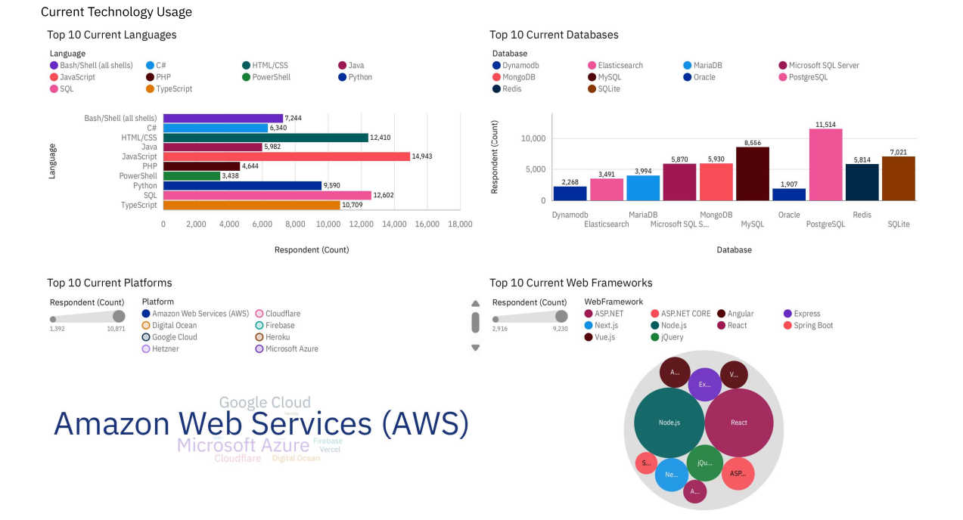
DASHBOARD 1

Slide 11
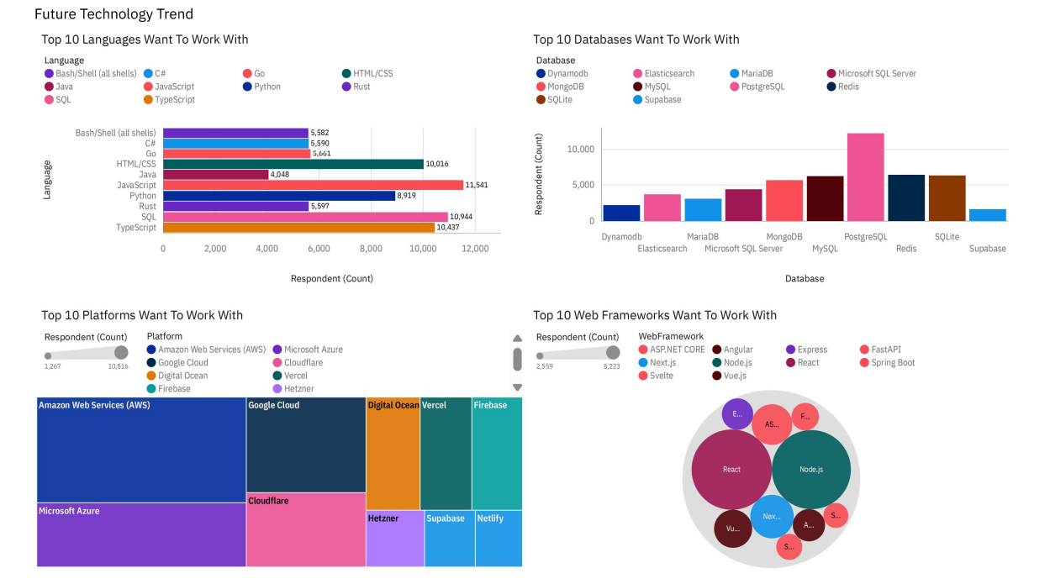
DASHBOARD 2

Slide 12
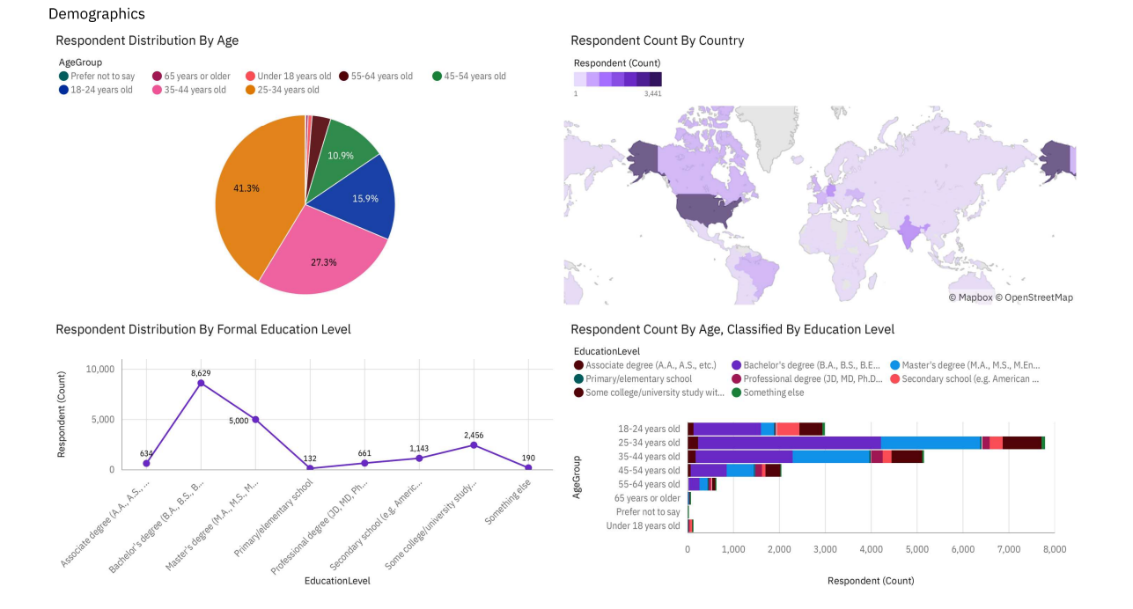
DASHBOARD 3

Slide 13

DISCUSSION
Young, global workforce dominates responses (18–34).
Higher education drives participation (Bachelor’s/Master’s).
JavaScript ecosystem leads across languages & frameworks.
Modern stacks rising (TypeScript, PostgreSQL, Redis).
Cloud-first development led by AWS & Azure.

Slide 14
OVERALL FINDINGS & IMPLICATIONS
Findings
JavaScript ecosystem dominates languages and frameworks.
PostgreSQL and SQL remain core database skills.
TypeScript, Redis, and modern tools show rising adoption.
Majority respondents are young and globally distributed.
Implications
Developers should prioritize JS, SQL, and cloud skills.
Organizations should adopt scalable, modern tech stacks.
Data and cloud literacy are now essential across roles.
Future systems will favor performance and scalability.

Slide 15

CONCLUSION
The technology landscape is dominated by the JavaScript ecosystem, supported by strong adoption of React and Node.js.
Data-driven development is central, with PostgreSQL and SQL remaining essential skills.
Modern and scalable technologies such as TypeScript, Redis, and cloud platforms are gaining momentum.
The workforce is young and globally distributed, shaping future technology trends.
Overall, the industry is moving toward cloud-first, performance-oriented, and scalable systems.

Slide 16
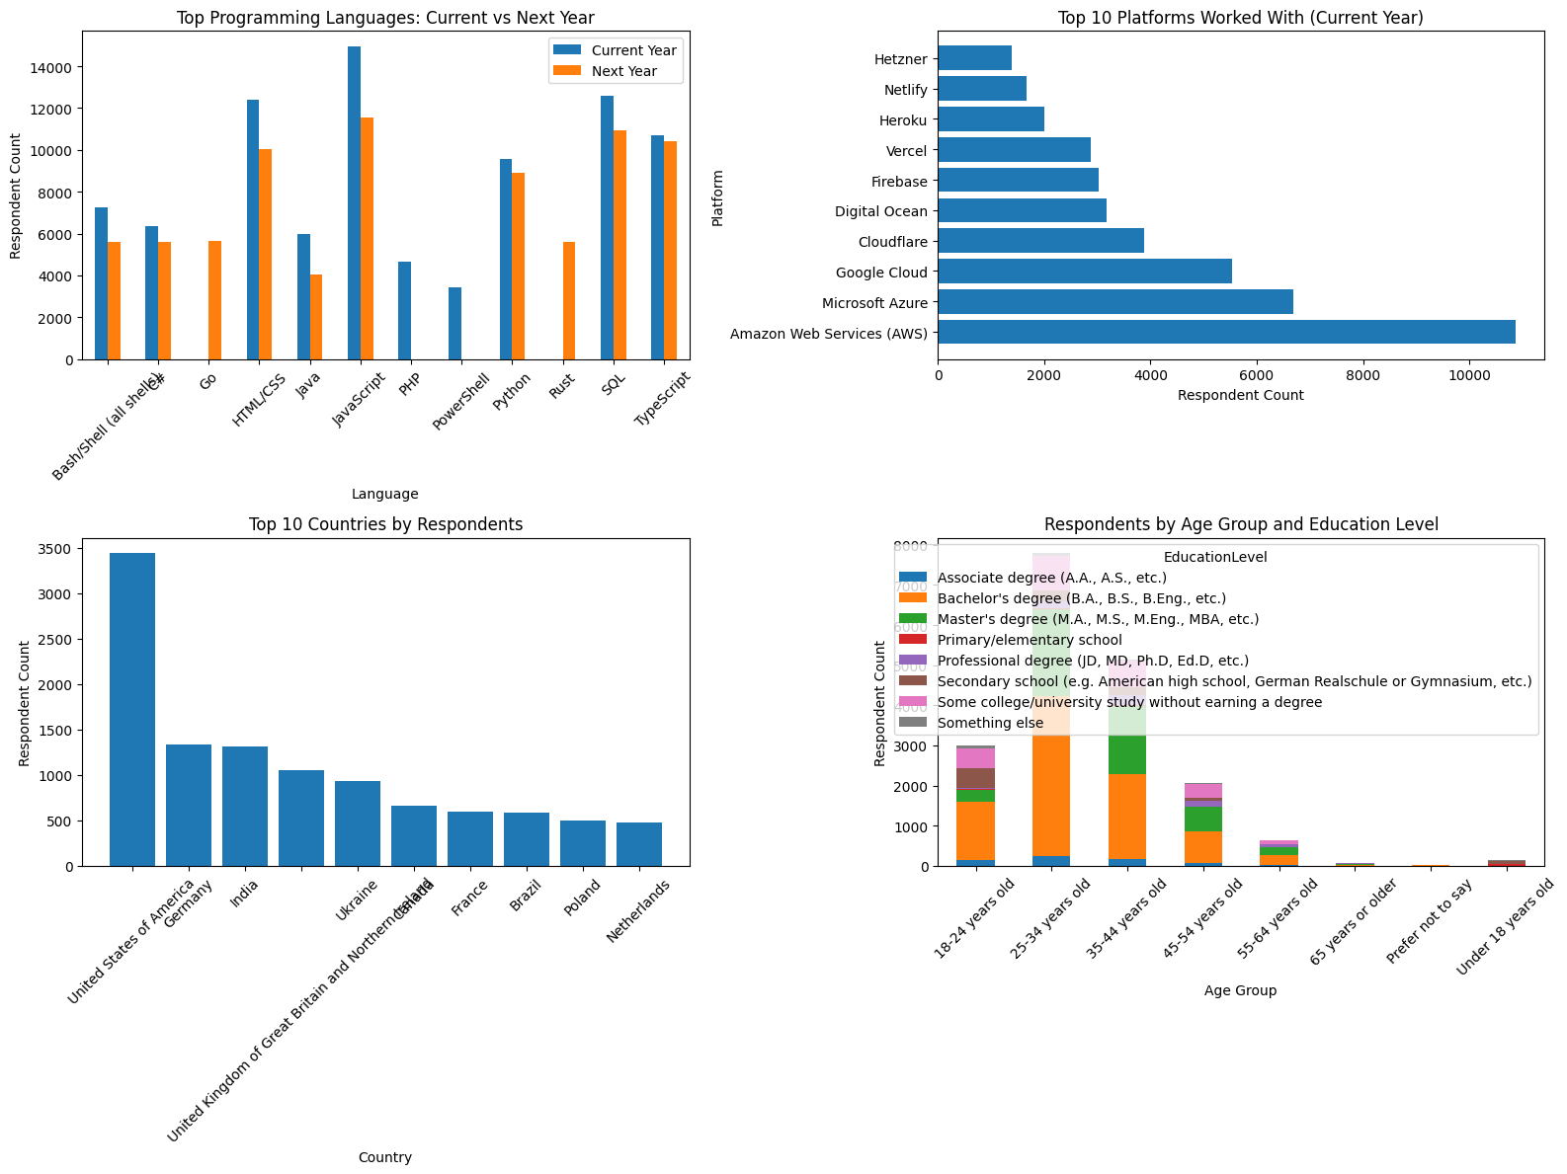

APPENDIX

Slide 17
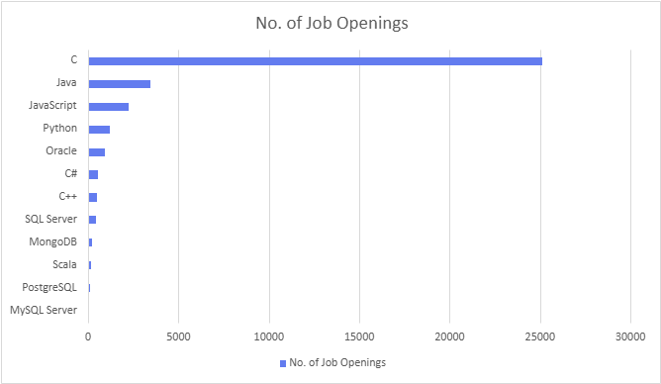
JOB POSTINGS

Slide 18
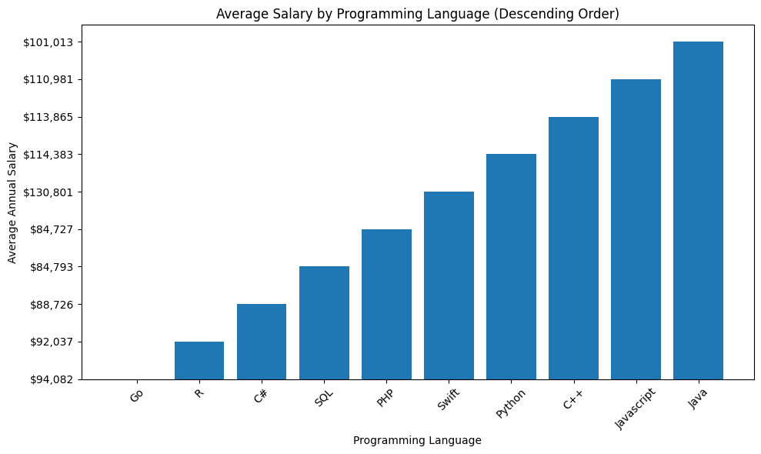
POPULAR LANGUAGES

